Slide 1
Define
Green Belt Training

Slide 2
Iterative Process
Define
Control
Measure
Improve
Analyze

Slide 3
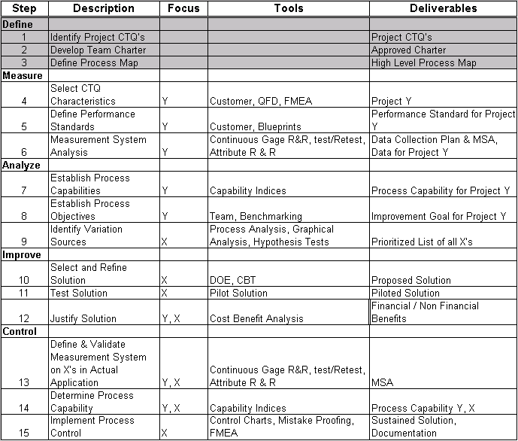
The 15-Step Process

Slide 4
Define Phase Overview
What is the Define phase?
The Define phase is when your team identifies:
Who your customers are and what their requirements are for your products and services
The reason for doing the project and project boundaries
The project team members and how they will work together
What process you are trying to improve and what the process map looks like

Slide 5
Define Phase Overview
Why is the Define phase important?
This phase is important because it clearly and precisely describes the goals of the project, aligns the project with organizational priorities and lays the groundwork that will allow the team to remain focused.

Slide 6
Define Phase Overview
Steps involved in the Define phase:
Define 1: Identify Project CTQ’s
Define 2: Develop Team Charter
Define 3: Define Process Map

Slide 7

Define 1–Identify Project CTQ’s
What does it mean to Identify Project CTQ’s?
Critical to Quality Characteristics, CTQ’s, are the key measurable characteristics of a project or process whose performance standards must be met in order to satisfy the customer.
Green Belt improvement projects typically focus on one or two CTQ’s of a process or product.

Slide 8
Define 1–Identify Project CTQ’s
Why is it important to Identify Project CTQ’s?
Project CTQ’s are important because they ensure that the improvement team is solving problems that are both critical to your customer and aligned with your business strategy.
If project CTQ’s are not identified and validated in this manner, valuable resources may be wasted on counterproductive projects that neither increase customer satisfaction nor add value to the business.

Slide 9
Define 1–Identify Project CTQ’s
What are the project tasks for completing Define 1?
Identify Customer
Collect Voice of the Customer data to identify customer CTQ
Build a process / product drill-down tree to identify project CTQ’s

Slide 10
Identify Project CTQ’s
Identify
Customers
VOC
Data
Determine
CTQs
List Customers
Define Customer Segments
Narrow List
Review Existing VOC Data
Decide What to Collect
Collect Data
Organize Data
Translate VOC into specific needs
Define CTQs for specific needs

Slide 11

Identify Customers
A customer is someone who
  Uses your product or service
  Decides to buy your product or service
  Pays for your product or service
  Gets impacted by your product or service
Internal & External customers
Primary & Secondary customers
Be Clear as to which customer group we are going to Impact

Slide 12

Identify Customers
Ops
Quality
Business
Clients
HP
Intuit
HR
Admin
Finance
End Users
Be Clear as to which customer group we are going to Impact

Slide 13

Collecting VOC
Six Sigma begins with the customer
Customers find it easier to define what they do not want
Customer CTQs are defined by customers
Sources of customer CTQs
    Survey results
    Interviews
    Conference Calls
    Focus Groups

Slide 14
Some Sample Customer Comments
A Car Purchaser
Good Acceleration
Spacious
Affordable
Power Steering
Loan Facility
A TV Purchaser
Flat Screen
Good Sound
NTSC / PAL Compatible
Affordable
Good After Sales Service
A Caller to Help Desk
Quick Answering
Courteous Response
Quick Problem Resolution
A Prospective Employee
Good Salary
Location Preference
Flexible Working Hours
ESOPs
Separate Cabin

Slide 15
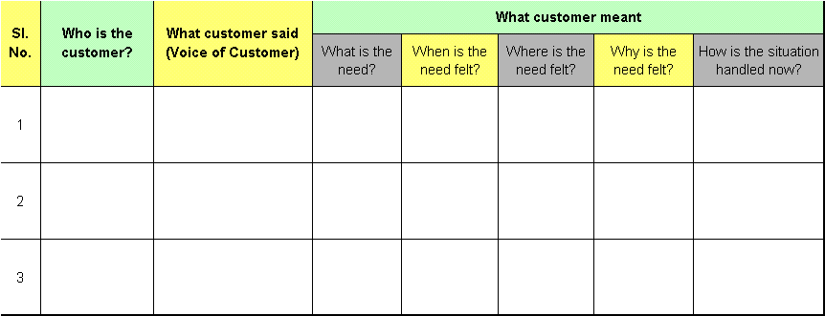
How to convert customer comments to VOC
Often, customer requirements are hazy
Customer requirements must be understood clearly
VOC Table is a technique to organize, analyze & profile the customer requirements
VOC Table

Slide 16

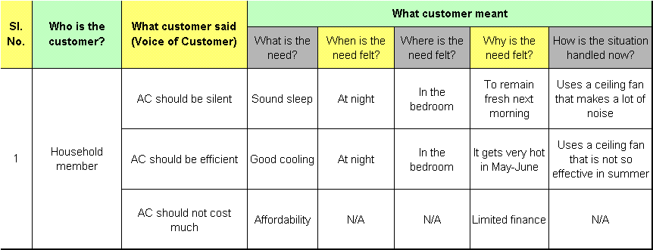
How to convert customer comments to VOC
Customer
comment
VOC Table
Analyzing Customer comments using 5W & 1H leads to CTQ Identification

Slide 17
Kano Diagram
Kano analysis classifies customer CTQs into three categories based upon the impact of the need on his satisfaction
Satisfaction
Delighters
Stated Needs
Completely Fulfilled
Implied Needs
Dissatisfaction

Slide 18
Implied Needs
Taken for Granted by Customer
Lack of Delivery causes high Dissatisfaction
Delivery does not cause Satisfaction
Not meeting Implied needs would lead to a very quick erosion in customer base
Satisfaction
Delighters
Stated Needs
Completely
Fulfilled
Implied Needs
Dissatisfaction
Implied Needs are “Critical Priorities” for the Business

Slide 19
Stated Needs
Demanded by Customer
Delivery causes Satisfaction
Lack of delivery causes Dissatisfaction
Under Promise – Over Deliver
Not meeting Stated Needs of the customer is generally reflected in lack of “Stable Client Relationships”
Satisfaction
Delighters
Stated Needs
Completely
Fulfilled
Implied Needs
Dissatisfaction
Stated Needs are “Competitive Priorities” for the Business

Slide 20
Delighters
Not usually thought of by Customer
Delivery causes high Satisfaction
Lack of delivery does not cause dissatisfaction
Noticed only by its presence / delivery
Generally explored by the businesses that are already in the Leadership Positions
Satisfaction
Delighters
Stated Needs
Completely
Fulfilled
Implied Needs
Dissatisfaction
Delighters are “Innovation Opportunities” for the Business

Slide 21
Kano Analysis: A Little Something Extra Can Have Big Results
How often have you been truly delighted by a dining experience? Recently, a co-worker and I had the good fortune to have such an experience.
We were in Arizona to deliver Six Sigma DMAIC training, and had dinner at the Macaroni Grill #135 in Phoenix. Our waiter was attentive and the food was good. We thoroughly enjoyed our dinner, but we were unable to finish it. The manager, Renee, stopped by to say hello and to ask whether we were enjoying our visit to the area and our meal. While we chatted, she offered to box our leftovers for us, at which time, my colleague requested that the sprig of rosemary that garnished her plate be included. She explained that for her, the rosemary represented a comforting smell and one that reminded her of her childhood.
While we finished our coffee, Renee prepared our take-home boxes and returned them to us with her thanks for visiting the restaurant and an invitation to return when we visited the area once more. The next day, we opened the bag containing our boxes. Imagine our surprise when we found not only our leftovers, but also a fresh loaf of bread, several large sprigs of rosemary, and a personal note of thanks from Renee for visiting the restaurant and wishing us well in our travels.
Needless to say, our dining experience delighted us, and the thoughtfulness of the manager, Renee, astounded us.

Slide 22
Shifting Needs
Over a period of time, Delighters become Stated Needs
Over a period of time, Stated Needs become Implied Need
Delighters
Stated
Needs
Implied
Needs
Time

Slide 23
Key Concepts
Focusing on Delighters may lead to a competitive advantage / USP
Implied needs have to be met
Stated needs – more the better (under-promise – over-deliver)
Initial projects must focus around Stated Needs & Implied Needs

Slide 24
Define 2–Develop Team Charter
What does it mean to Develop a Team Charter?
A charter is a document that establishes a purpose and plan for the project. It contains a statement of the problem, the scope of the project (including the process to be improved) and an improvement goal, a plan and schedule for the project, estimated financial benefits, and a list of team members and their roles. The charter becomes the blueprint for the project when key stakeholders approve it.

Slide 25

Define 2–Develop Team Charter
Why is it important to Develop a Team Charter?
The charter documents the expectations, boundaries, and business case for your project and can help you identify necessary resources. It is also a key communication tool that can help your team stay focused and help you share information about your project with each other and with the business. An approved charter ensures that your team, sponsor and stakeholders agree up front on what is being done and that your project will have a beneficial impact on the business.

Slide 26
Define 2–Develop Team Charter
What are the project tasks for completing Define 2?
Define the business case
Develop problem statement
Develop goal statement
Assess project scope
Select project team and define roles
Set Milestones
Get sign-off for team charter

Slide 27
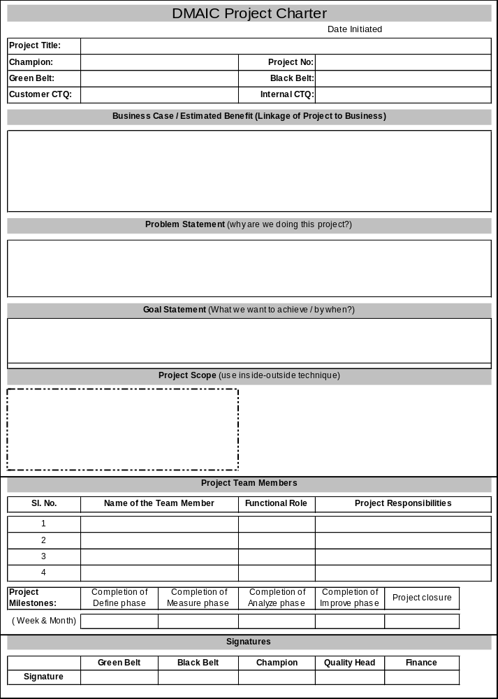

Define 2–Develop Team Charter

Slide 28
Define 2–Develop Team Charter
Business Case
High level brief of process / project
WHY is it IMPORTANT to do this project?
Why is it important to do this project NOW?
What would happen if this project is not done?
What will be the impact of this project in case of a successful closure?
Start and Stop Points
Project boundaries
Scope
What processes, systems, products, services, channels, etc. will you consider / exclude in this project?
In Scope
Out Scope
Problem Statement
WHAT is the problem?
How big is the problem? (use real data or leave blanks to fill in when you get the data
When was the problem evident? (dates that the data represents or was collected)>
What is the impact of the problem (time, $, customer satisfaction, etc.)
Defect
Goal
Opportunity
Unit
DPMO
Sigma
Goal Statement
The Goal statement should be S*M*A*R*T*
(“ Specific, Measurable, Attainable, Relevant, Time bound)
Always start with a verb..”Increase, Reduce, Improve”

Slide 29
Team Activity…15 minutes
Develop a Team Charter for the following scenarios. Leave blanks where you do not have numbers available
Case A: Current AHT for the process is 22 as against a target of 18
Case B: Cycle Time of the Full and Final Settlement is 30 days as against the industry average of 14 days
Case C: The CSat scores for the process are at 50% as against a target of 70%
Case D: The current Attrition percentage for Daksh is at 6% (monthly) as against the industry average of 4%

Slide 30

Project Milestones
A detailed project plan with key steps and target completion dates
Tied to phases of DMAIC process, with defined tollgate reviews
Aggressive (don’t miss “window of opportunity”)
Realistic (don’t force yourselves into “quick fix” solution)

Slide 31

Define 3–Define Process Map
What does it mean to Define a Process Map?
A high-level process map is a chronological display of the most significant four to five steps, events, and operations in a process. It provides a structure for defining a process in a simplified, visual manner. The high-level map gives you an overall view of an entire process and lays the foundation for thinking about the process in more detail.

Slide 32
Define 3–Define Process Map
Why is it important to Define a Process Map?
A high-level (SIPOC) map will help you understand the process and validate your project scope. It is a bridge between the problem and scope statements in your charter and the more detailed maps you will develop to help you improve the process.
A high level map provides focus for the team and helps you identify areas that are within (as well as beyond) your control.
In addition, process mapping serves as a communication tool that helps you to clarify the process to others, both internally and externally to the business.

Slide 33
Define 3–Define Process Map
What are the project tasks for completing Define 3?
Develop high-level Process Map

Slide 34
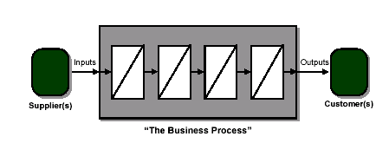

What is a Process
A Collection of Activities that takes one or more inputs and transforms those into outputs that are valuable to the customers
Processes must ultimately provide Value to the Customers

Slide 35
Process Elements
Supplier: The provider of inputs to your process
Input: Materials, resources or data required to execute your process
Process: A collection of activities that takes one or more kinds of input and creates output that is of value to the customer
Output: The products or services that result from the process
Customer: The recipient of the process output – may be internal or external
CTQs: Critical-to-quality characteristics; A specific attribute or quality of the output that is a key requirement for customer satisfaction
Boundary: The limits of a particular process, that define the start and stop points of the process

Slide 36
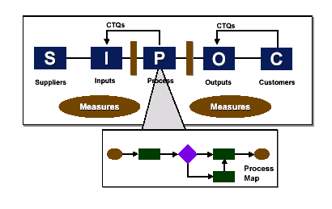
High Level Process Map / SIPOC
Process mapping is the graphic display of steps,events and operations that constitute a process.
The SIPOC map (which stand for Supplier, Input, Process, Output and Customer) is a simple tool that facilitates the documentation of any business process.
This model is applicable to both product and service processes.

Slide 37
High Level Process Map / SIPOC
S
I
P
O
C
List Suppliers Here
Enter Inputs Here
Enter steps Here. The text will “word wrap” for you.
Enter Outputs Here
List Customers Here

Slide 38
Process Map
Determine the scope
  How complex and detailed a map do you need to give you what you want?
Determine the steps in the process
  Don’t worry about order
  Don’t worry about priorities
  Just list them!
Arrange the steps in order
Assign a nomenclature (See next page)

Slide 39
Process Mapping Nomenclature
Alternate
Process
Decision
Data
Process
Predefined
Process
Document
Terminator
Preparation
Manual Input
Manual
Operation
Delay
Display
Extract
Y
Merge
N
Decision Arrows

Slide 40

Process Map Example: Pizza Home Delivery
No
Call
Answered?
Enter
customer details
in the system
Customer calls
Yes
Credit card?
Confirm
payment
type
Take
order
details
Take
card
details
Yes
No
Despatch
order
Deliver &
collect money,
if non-credit card
customer

Slide 41
Testing the Process Flow
No
Call
Answered?
Enter
customer details
in the system
Customer calls
Yes
Take
card
details
Credit card?
Confirm
payment
type
Take
order
details
Yes
No
Despatch
order
Deliver &
collect money,
if non-credit card
customer
Testing the Flow
Are the process steps identified correctly?
Is every feedback loop closed?
Does every arrow have a beginning and ending point?
Is there more than one arrow from any activity box? Perhaps it could be a diamond.
Are all the steps covered?

Slide 42
Benefits of Process Mapping
The Benefits Of Process Mapping Include:
A structure for thinking through a complex process in a simplified, visible manner
An ability to “see” the entire process as a team
An ability to “see” that changes are not made in a vacuum and will carry through, affecting the entire process down the line
The magnification of non value-added areas or steps
The ability to identify cycle times for each step in the process

Slide 43


Class Exercise – 20 Minutes
Draw up a detailed process map for the pictures given to you
Pass on the process map to the team to your left.
Now reconstruct the picture with the process map given to you.
Objective of the exercise: Your process map has to be descriptive enough for the 2nd team to reconstruct the picture without looking at it.

Slide 44
DMAIC Checklist–Define 1
Identify customer
  Have you considered both internal and external customers?
  Have you focused on the most important customer segment(s)?
Collect voice of the customer data to identify customer CTQ’s
  Have you collected data to understand customer requirements?
  Have you coordinated your data collection with others who are collecting similar data, so as not to overwhelm the customer?
  Have you validated the customer CTQ’s (Big Y) with the customer?
  Have you verified a VOC Research method that you’ve selected that reflects the true VOC?
Build a process/product drill-down tree to identify project CTQ’s
  Is your project CTQ focused on what’s most important to the customer?
  If you have multiple CTQ’s, have you used the appropriate tool to prioritize them?

Slide 45
DMAIC Checklist–Define 2
Define the business case
  Is the business case compelling to the team?
  Does this business case illustrate why this project needs to be done now ?
Develop problem statement
  Does your problem statement identify a problem and not prejudge a root cause or attempt to solve a problem?
  Is the problem statement linked to the project CTQ?
  Is the problem statement based on facts not assumptions?
Develop goal statement
  Is your goal statement SMART (Specific, Measurable, Attainable, Relevant, Time bound)?
  Does your goal statement focus on what needs to be improved, and without predetermining a solution?
  How will you know the team is successful?
Project scope
  Does your team agree on the project scope?
  Is your project scope within the team’s control?
Roles
  Are all functions represented?
  Does each team member fully represent their manager’s input on the project?

Slide 46
DMAIC Checklist–Define 3
Develop high-level process map
  Does the COPIS scope (start and stop) match the scope definition in your team charter?
  Have you mapped the process from your customer's perspective?
  Is this the “As-Is” process? Was the map validated with the people who actually do the process

Slide 47

Project Sign-Off
Champion’s sign-off ensures a common understanding of deliverables
It reflects his approval on team members financials
Formal sign-off is a must

Slide 48
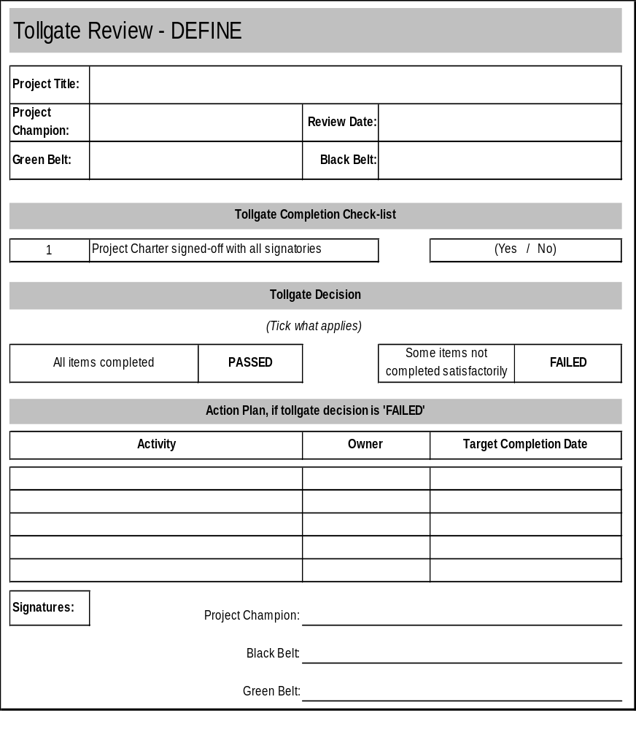


Tollgate - Define

Slide 49
Quiz

